Slide 1
Mode of Intervention
Unit 8

Slide 2
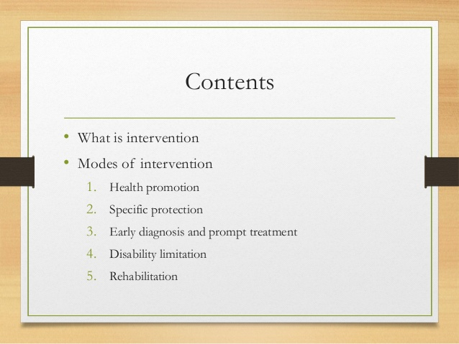

Slide 3
Intervention 1
Action taken by health person on the behalf of communities, the individual and families
The assumption of the intervention is population based (focus on the population; assessment, identify determinants of health, consider all level of prevention and practice)
Definition: any attempt to intervene/ interrupt the usual sequence in the development of disease in human this may be done by the provision of treatment, education, help or support.

Slide 4
Intervention 2
An intervention is a combination of program elements or strategies designed to produce behavior changes or improve health status among individuals or an entire population.
Interventions may include educational programs, new or stronger policies, improvements in the environment, or a health promotion campaign.
Interventions that include multiple strategies are typically the most effective in producing desired and lasting change.

Slide 5
Intervention 3
Interventions may be implemented in different settings including communities, worksites, schools, health care organizations, faith-based organizations or in the home.
Interventions implemented in multiple settings and using multiple strategies may be the most effective because of the potential to reach a larger number of people in a variety of ways.

Slide 6
Intervention 4
Evidence has shown that interventions create change by:
influencing individuals’ knowledge, attitudes and beliefs;
offering promotions, rewards or incentives;
providing social support;
shaping environments and policies; and
using clinical treatments.

Slide 7
What is an intervention? 5
Interventions come in many shapes and sizes. An intervention might be a program, a policy change, an environmental change, a campaign, a new partnership or a different practice or way of doing things. What these things all have in common is that they create change. In public health, these changes are meant to influence individual behaviors and health as well as the environments to support those individuals.

Slide 8
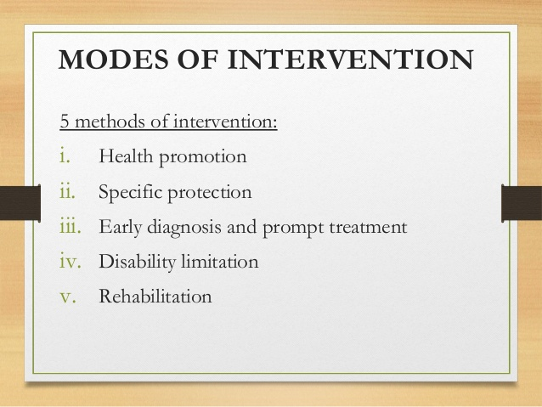

Slide 9
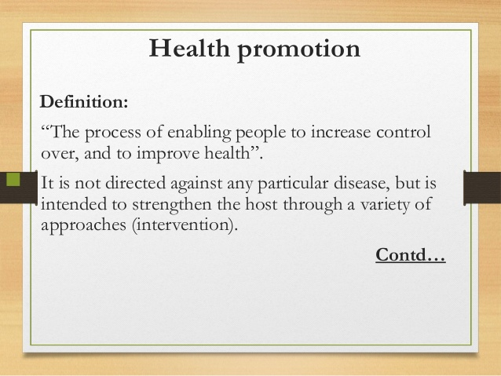

Slide 10
Health promotion
Health education: cost effective intervention, huge number of disease can be prevented (precaution on time), WHO state that the extension to all people of the benefit of medical, psychological and related knowledge is essential to the fullest attainment of health.
Environmental modification: provision of safe drinking water, use of sanitary latrine, control of insect and rodents, improvement of housing patterns
Nutritional intervention: food distribution and nutrition improvement of vulnerable groups, food fortification, nutritional education

Slide 11
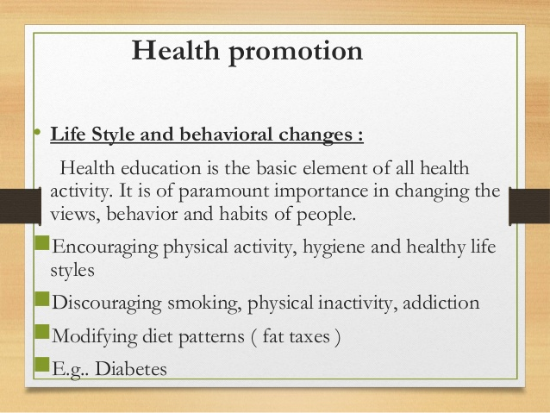

Slide 12
Specific protection
Immunization
Use of specific nutrients
Chemoprophylaxis
Protection against occupational hazards and accident
Protection from carcinogens
Avoidance of allergens
Better environmental conditions eg: control of air, noise pollution
Control of consumer product quality and safety of food, drug, cosmetics

Slide 13
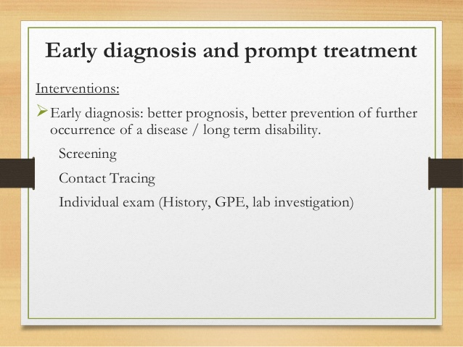

Slide 14
Early diagn0sis of treatment
Main intervention of disease control
Reduce morbidity and mortality
Good quality (diagnostic test and combination of treatment) to reduce the risk of causative factors resistance to medicines
Prompt and accurate diagnosis- essential for effective disease management
Should be treated early with safe and effective medicine to cure disease
Sometimes a mass treatment approach is used in the control of certain disease

Slide 15
Disability limitation
WHO; Disabilities is an umbrella term, covering impairment, activity limitations, and participation restrictions.
Problem experienced by an individual in life situations
The objective of this intervention is to prevent the transition of disease process from impairment to handicap
The major causes of disabling impairment in developing countries are communication disease, nutritional deficiencies, low quality of prenatal service and care and accident

Slide 16
Rehabilitation
Rehabilitation is the process of helping an individual achieves the highest level of independence and quality of life possible-physically, emotionally, socially and spiritually
Rehabilitation does not reverse or undo the damage caused by a disease/did order but rather helps restore the individual to optimal health, functioning and well-being

Slide 17
Rehabilitation
Medical rehabilitation | Restoring the function
Vocational rehabilitation | The capacity to earn the livelihood
Social rehabilitation | Restoration of family and social relationship
Psychological rehabilitation | Restoration of dignity and personal confidence

Slide 18
Thank you!!

